Slide 1
A Foundation for Success:
Advocacy, Engagement, and Addressing Gaps in Policy
Charlie Lotz and Ray Firth
February 15th, 2018

Slide 2
A Strong Research Base
Helping Families Raise Healthy Children Initiative (2013) – RAND Corporation
Allegheny County (Pittsburgh), Pennsylvania
Goal: improve maternal and infant health by improving access to care
Outcome: Early Intervention model
Increased maternal referral rate after positive depression screening (62% vs. 52%)
Increased maternal engagement (71% vs. 37%)

Slide 3
Real Change – Without Reinventing the Wheel
Limited scope of legislation (SB 200 / HB 200)
Simply adds one more qualifying category to receive EI screening and tracking: infants whose mothers screen at risk for depression
Early Intervention already in all 67 PA counties
Major impact: benefits both moms and babies statewide

Slide 4
The Right Champions
Sen. Bartolotta Sen. Schwank Rep. Toohil Rep. Schlossberg
Bipartisan
Invested
Capable

Slide 5
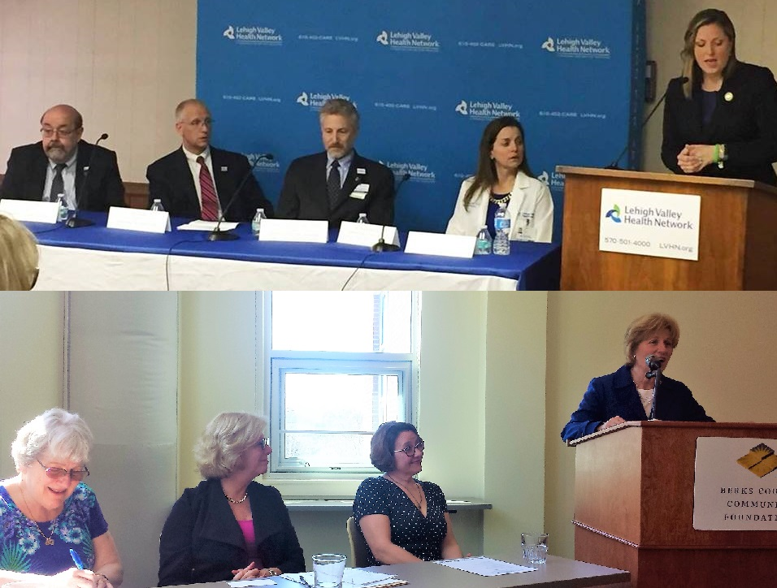
A Novel Approach
Town Hall Events
Social media campaign / geofencing

Slide 6
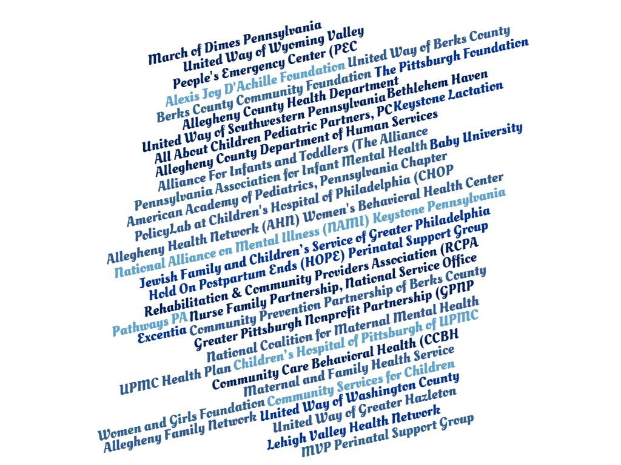
A Diverse, Engaged Coalition

Slide 7
An Incredible Team
Thanks to:
United Way of Washington County, PA
United Way of Southwestern Pennsylvania
The Pittsburgh Foundation
John Denny, Denny Civic Solutions
Blender, Inc.
Kris Knieriem
Katy Albert
Abby Mathieu
Chris Hays
Helping Families Raise Healthy Children Initiative
Ray Firth
Brian Baxter
Ridge Policy Group
Bev Mackereth
Mark Campbell
Kerry Lange
Buchanan Ingersoll & Rooney
Chuck Kolling
Meghan Fisher
All of our coalition partners

